Slide 1
Daniel Pink Drive
Workplace Motivation

Slide 2
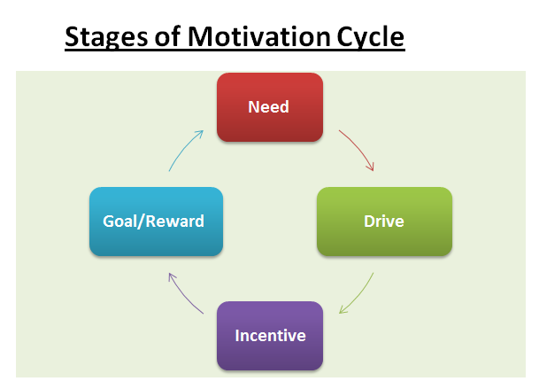
Workplace Motivation

Slide 3
Operating Systems
Motivation 1.0-Essential Survival Needs
Motivation 2.0-Carrot-Stick Philosophy
Motivation 3.0-Autonomy, Mastery, Purpose

Slide 4
Types of Jobs
Follows a set course
Usually mundane tasks prescribed by a manager
Uses an ‘algorithm’ to get from point A to point B
More empathic, artistic, non-routine
Does not follow a set path
Creates solutions to problems
Algorithmic
Heuristic

Slide 5
Motivation 2.0
Mostly algorithmic jobs
Carrot/Stick philosophy
Reward employees with carrots
Use a stick to punish poor performance

Slide 6
Flaws with Carrot/Stick
Extinguishes intrinsic motivation
Diminishes performance
Crushes creativity
Crowds out good behavior
Encourages unethical behavior
Becomes addictive
Fosters short-term thinking

Slide 7
Replacing Carrots and Sticks
Offer a rationale about why the task is necessary.
Acknowledge that the task is boring.
Allow people to complete the task their own way.
Give non-tangible vs. ‘if-then’ rewards.

Slide 8
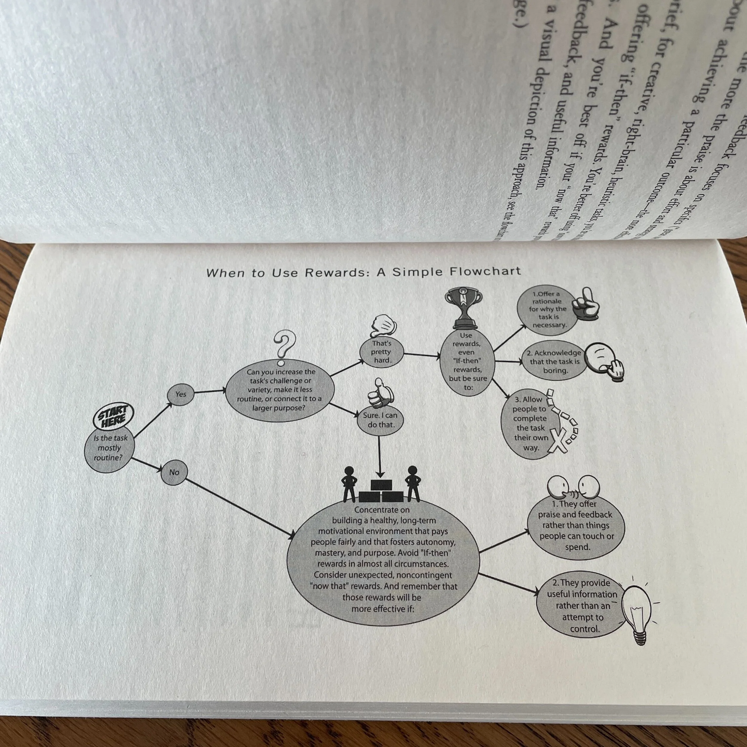

Slide 9
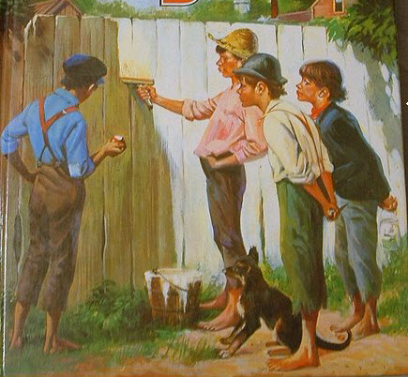
Tom Sawyer Effect
Convincing others that work is play
People will be more motivated if they enjoy what they are doing.

Slide 10

Fish Philosophy
Having Fun at Work
Be there
Play
Make their Day
Choose Your Attitude
Fish Philosophy

Slide 11
Personality Types
Extrinsic
Type ‘A’ Personality
Of the 2.0 mindset
Learned behavior
Intrinsic
Type ‘B’ Personality
Outperform Xs
Default Setting
Type X
Type I

Slide 12
Elements of 3.0
Autonomy
Mastery
Purpose

Slide 13
Autonomy
ROWE- results only work environment
Management as a prod or reward is outdated and assumes that people have no direction without it
Study shows that small-businesses experience greater results by allowing workers to be autonomous.

Slide 14
Four Essentials of Autonomy
Task
Time
Technique
Team

Slide 15
Task
Letting people choose what they want to work on
Examples:
FedEx Days
20% Time

Slide 16
Time
Allowing employees to take vacation and time off when needed without limits
ROWEs allow employees to come and go as long as they finish the required tasks.
Moving away from time-clocks and structured schedules

Slide 17
Technique
Allowing employees to heuristically take on tasks.
Example: Zappos has no scripts or time limits, just a goal of helping customers

Slide 18
Team
The least developed of the Four Ts of Motivation 3.0
Allows people to choose who they work with.

Slide 19
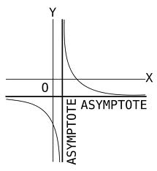
Mastery can be…
a Mindset
a Pain
an Asymptote

Slide 20
Mastery as Mindset
Intelligence, entity vs. incremental
Those who see intelligence as incremental or something they can grow and build on tend to be more successful

Slide 21
Mastery as Pain
Something that we push for
Grit-perseverance and passion for long term goals
Example: West Point Cadets

Slide 22
Mastery as Asymptote
A goal that can be pursued but never reached
Approaches a line but never meets it
Why go for it? Pink says, why not?

Slide 23
Autotelic Experience
Moments of Flow
Forgetting one’s self in a function
In a constant pursuit of goals

Slide 24
Goldilocks Effect
Finding just the right niche for an employee between what they must do and what they can do
Utilizing an employee at their optimum performance keeps them engaged

Slide 25
Purpose
Baby boomers and Millenials searching for careers or encore careers that help the human cause
Businesses find that donating to charities increases morale
Essential to 3.0 operating system but doesn’t work with 2.0

Slide 26

